Slide 1
Overfitting Underfitting Regularization

Slide 2
Model
In machine learning, generalization usually refers to the ability of an algorithm to be effective across a range of inputs and applications.
Suppose that we are designing a machine learning model.
How a model is said to be a good machine learning model? -> By checking if it generalizes any new input data from the problem domain in a proper way.
This helps us to make predictions in the future data, that data model has never seen.
A model is good if it neither Underfits or Overfits.

Slide 3
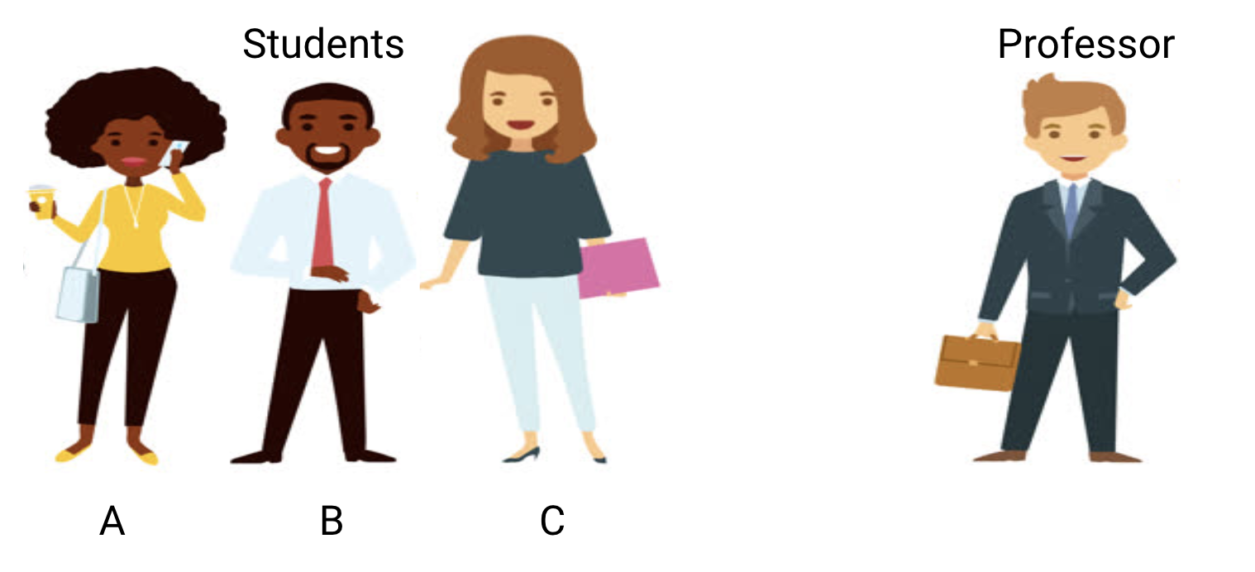
Example to Understand Underfitting vs. Overfitting
Consider a math class consisting of 3 students and a professor.
Now, in any classroom, we can broadly divide the students into 3 categories.

Slide 4
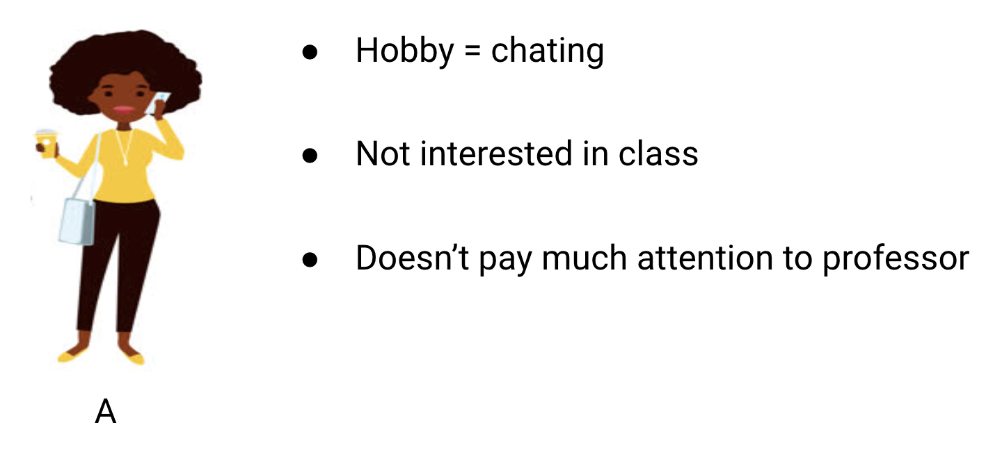
student A resembles a student who does not like math.
She is not interested in what is being taught in the class and therefore does not pay much attention to the professor and the content he is teaching.

Slide 5
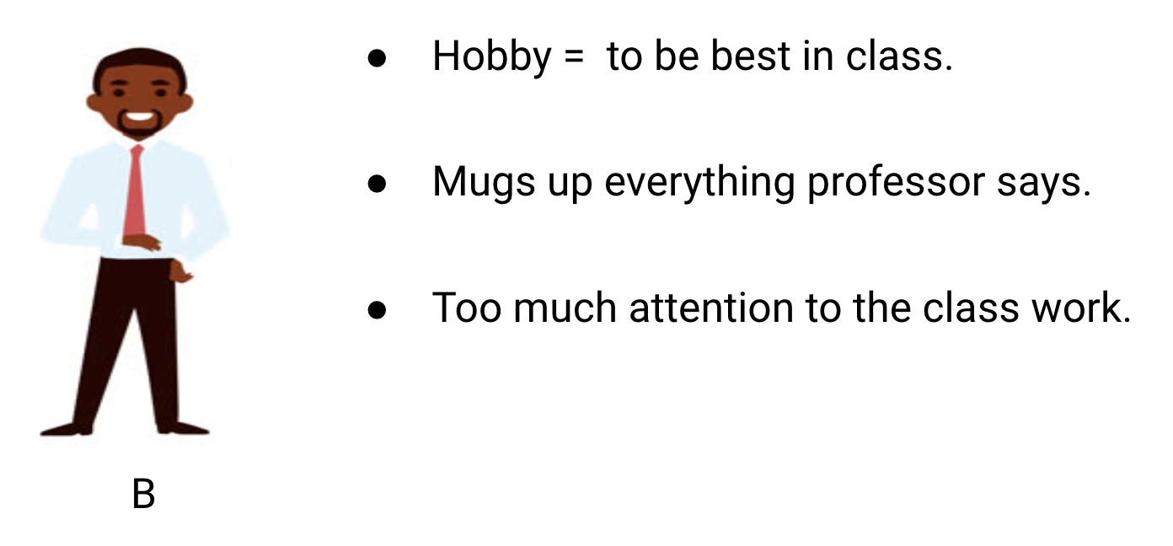
student B. He is the most competitive student who focuses on memorizing each and every question being taught in class instead of focusing on the key concepts.
Basically, he isn’t interested in learning the problem-solving approach.

Slide 6
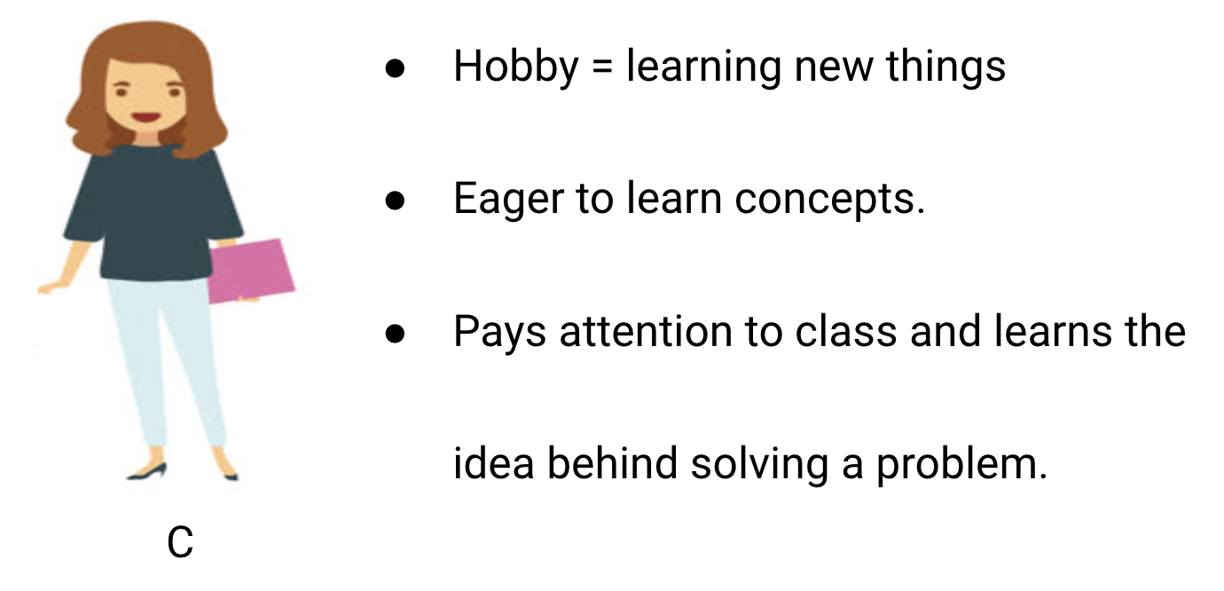
Finally, we have the ideal student C. She is purely interested in learning the key concepts and the problem-solving approach in the math class rather than just memorizing the solutions presented.

Slide 7
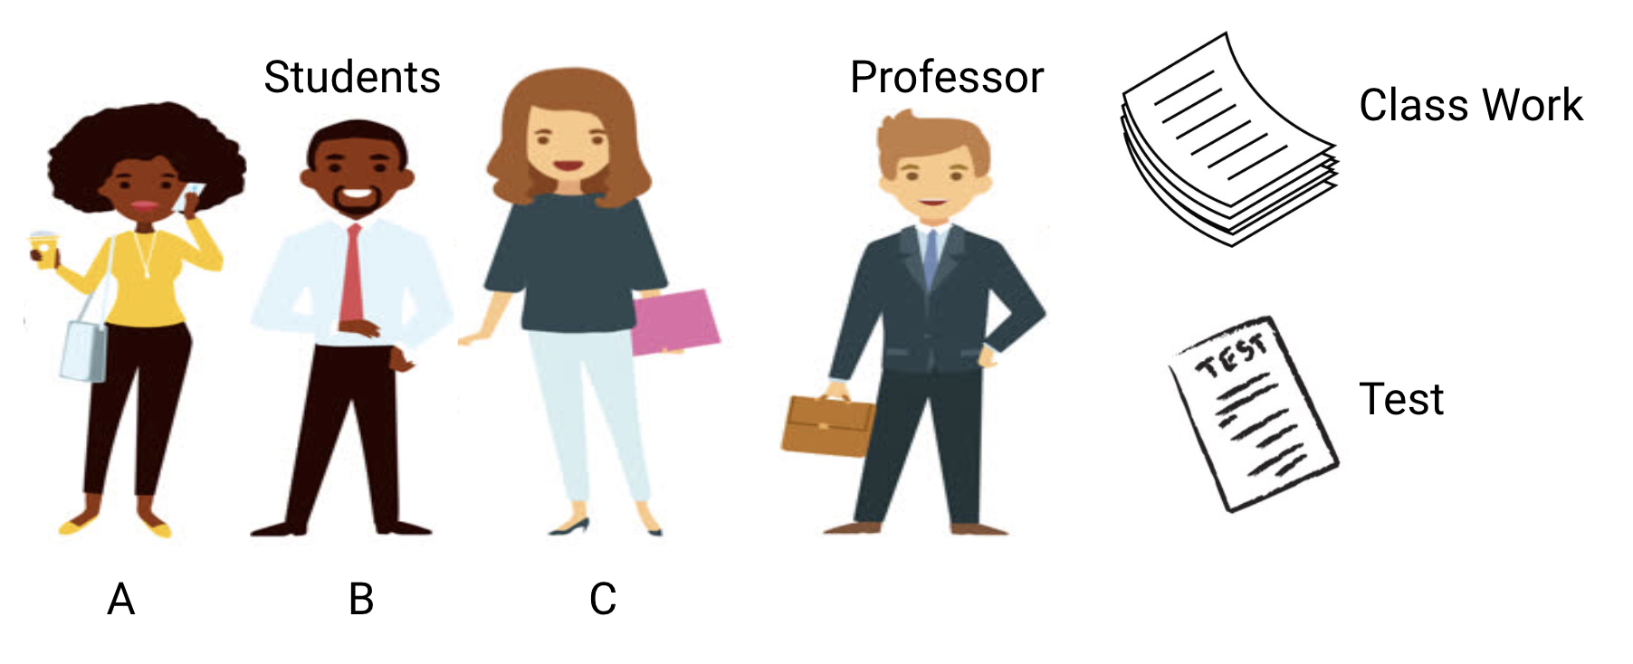
The professor first delivers lectures and teaches the students about the problems and how to solve them. At the end of the day, the professor simply takes a quiz based on what he taught in the class.
The obstacle comes in the semester tests that the school lays down. This is where new questions (unseen data) comes up. The students haven’t seen these questions before and certainly haven’t solved them in the classroom. Sounds familiar?

Slide 8
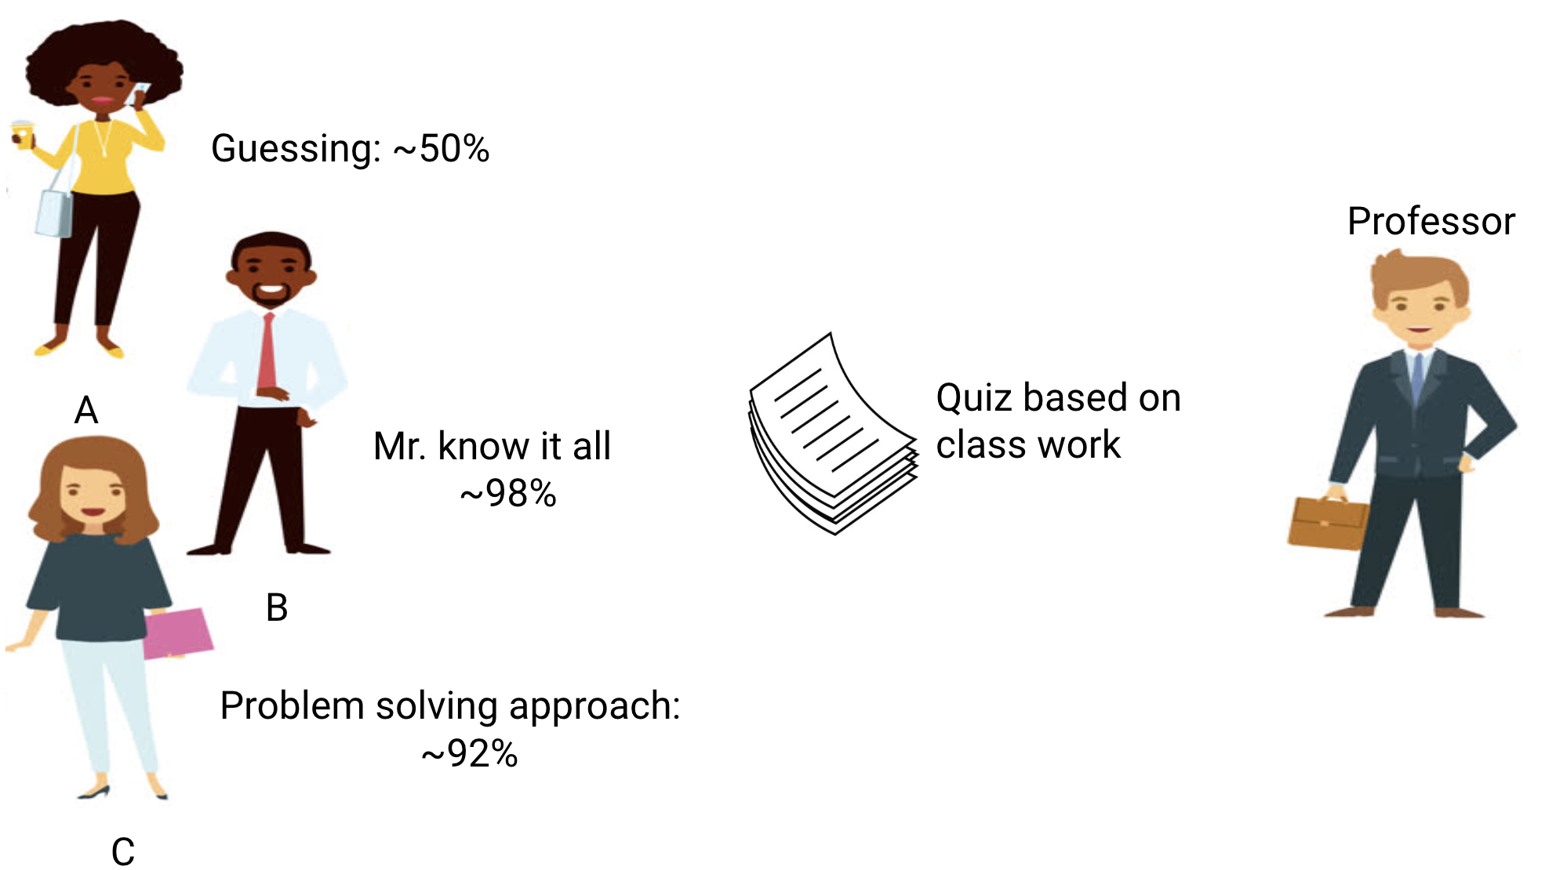
Student A, who was distracted in his own world, simply guessed the answers and got approximately 50% marks in the test
On the other hand, the student who memorized each and every question taught in the classroom was able to answer almost every question by memory and therefore obtained 98% marks in the class test
For student C, she actually solved all the questions using the problem-solving approach she learned in the classroom and scored 92%

Slide 9
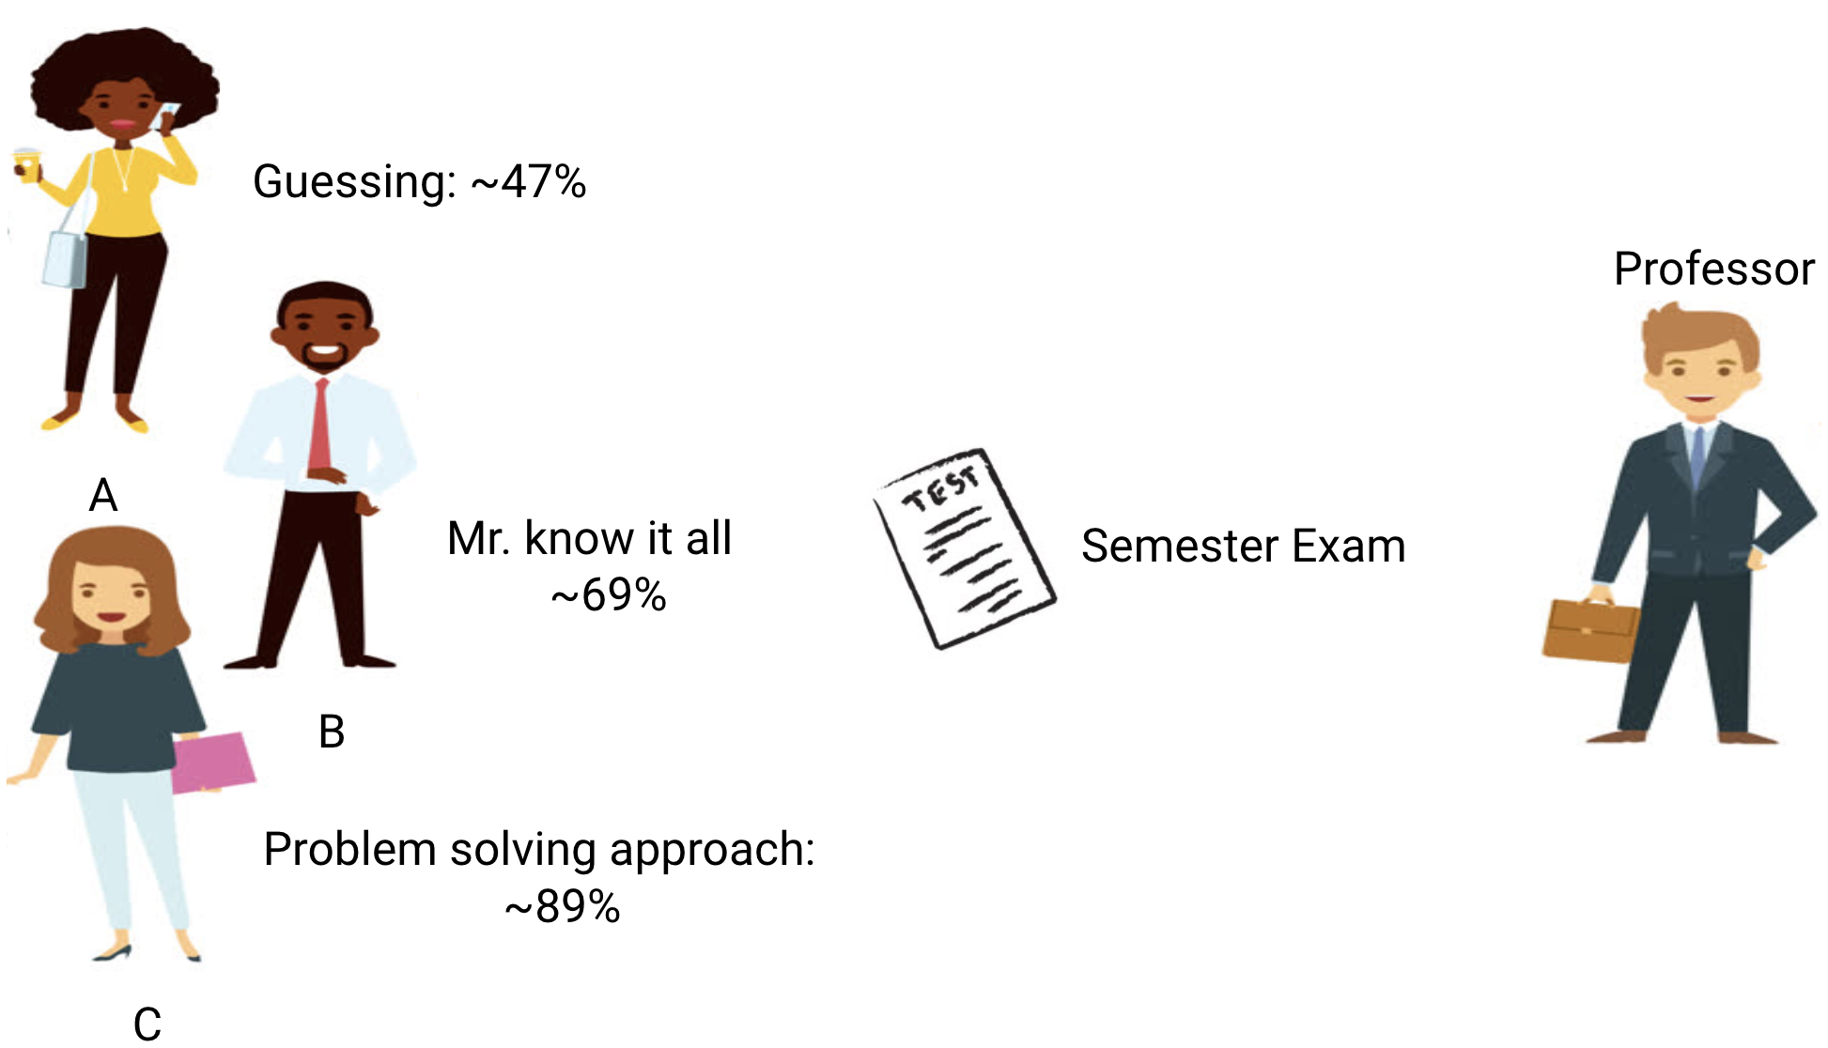
Let’s also look at what happens during the monthly test, when students have to face new unknown questions which are not taught in the class by the teacher.

Slide 10
In the case of student A, things did not change much and he still randomly answers questions correctly ~50% of the time.
In the case of Student B, his score dropped significantly. Can you guess why? This is because he always memorized the problems that were taught in the class but this monthly test contained questions which he has never seen before. Therefore, his performance went down significantly
In the case of Student C, the score remained more or less the same. This is because she focused on learning the problem-solving approach and therefore was able to apply the concepts she learned to solve the unknown questions

Slide 11
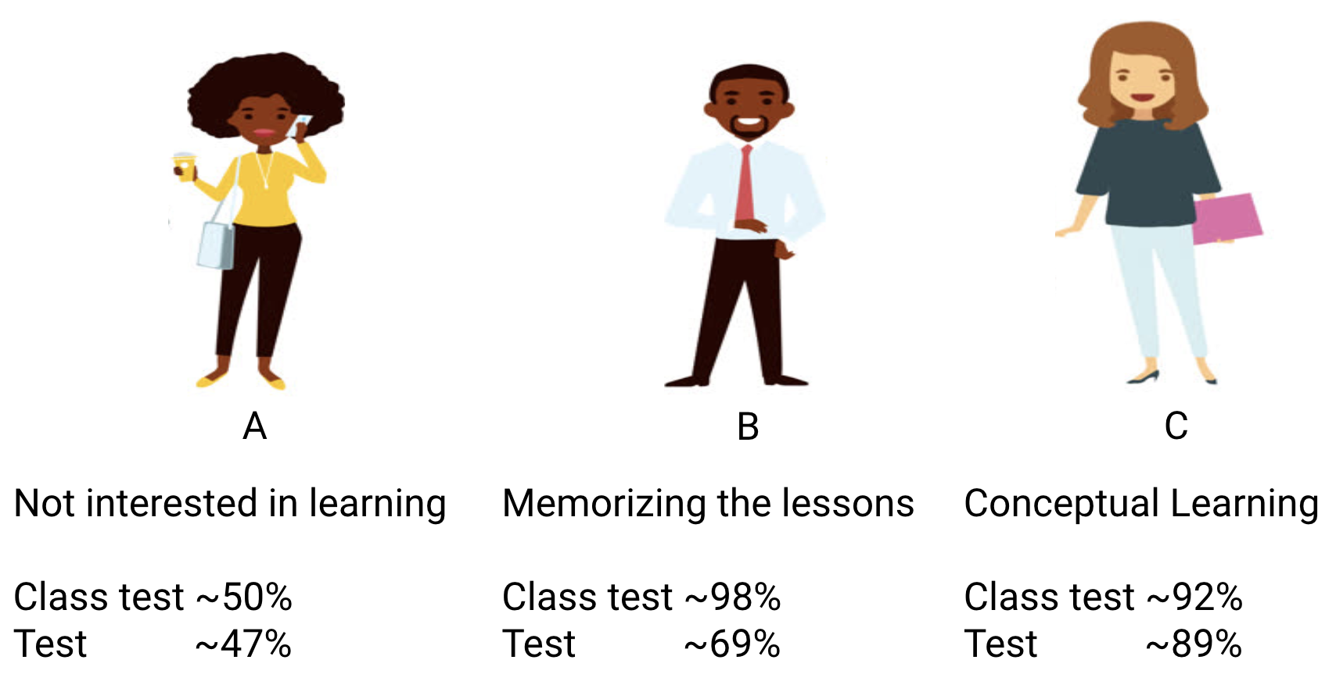
How Does this Relate to Underfitting and Overfitting in Machine Learning?

Slide 12
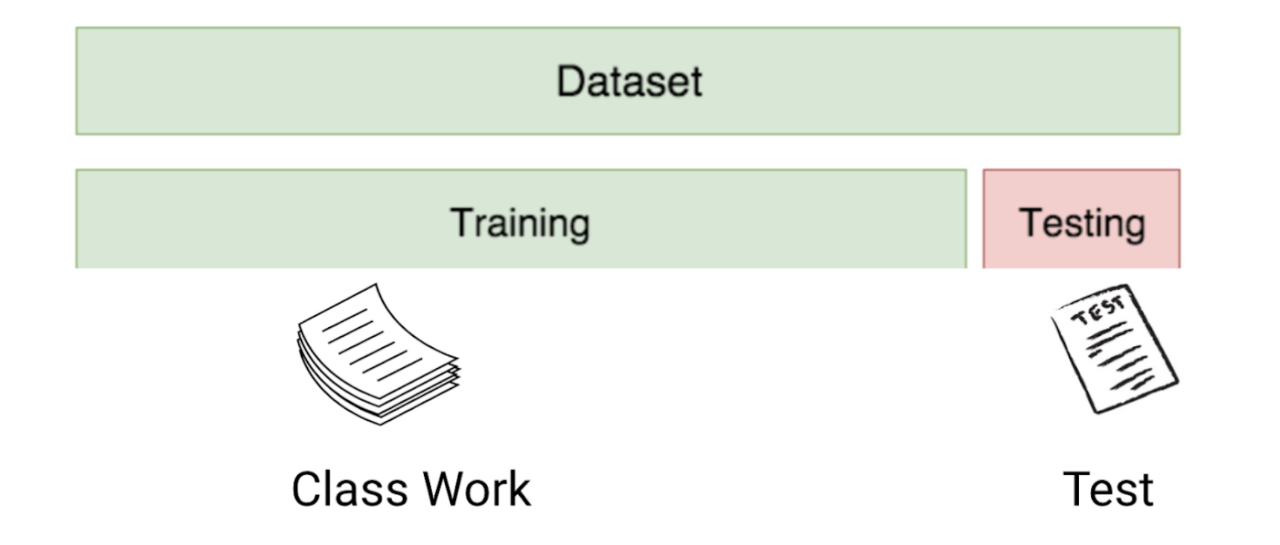
First, the classwork and class test resemble the training data and the prediction over the training data itself respectively.
On the other hand, the semester test represents the test set from our data which we keep aside before we train our model (or unseen data in a real-world machine learning project).

Slide 13
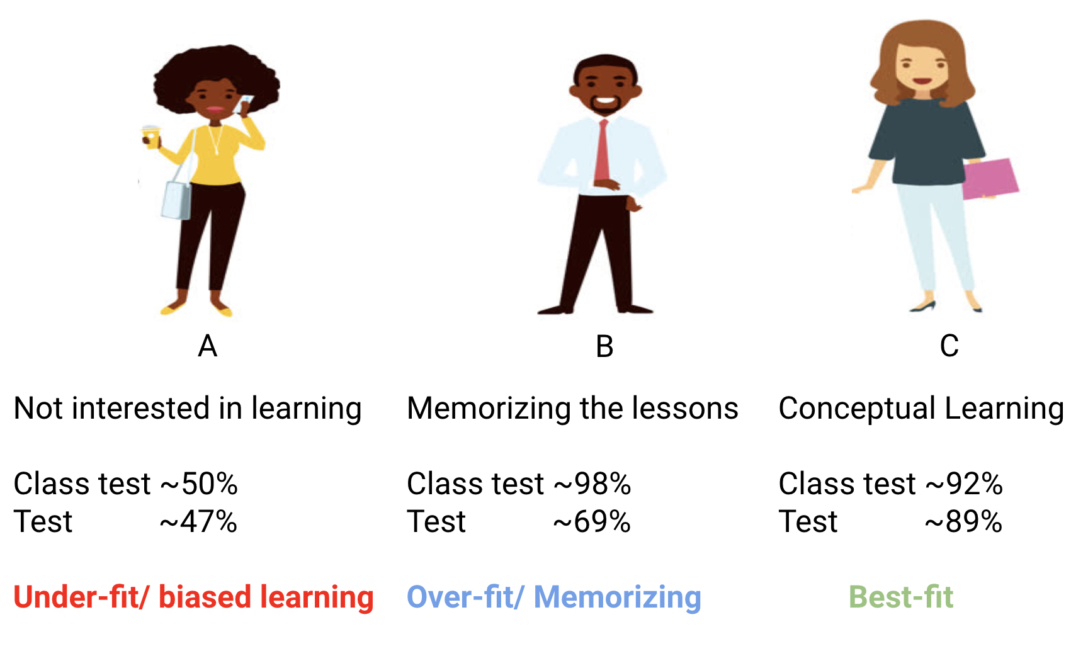

Slide 14
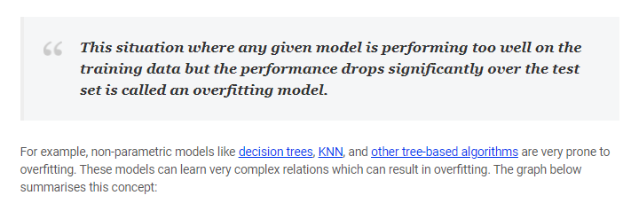

Slide 15
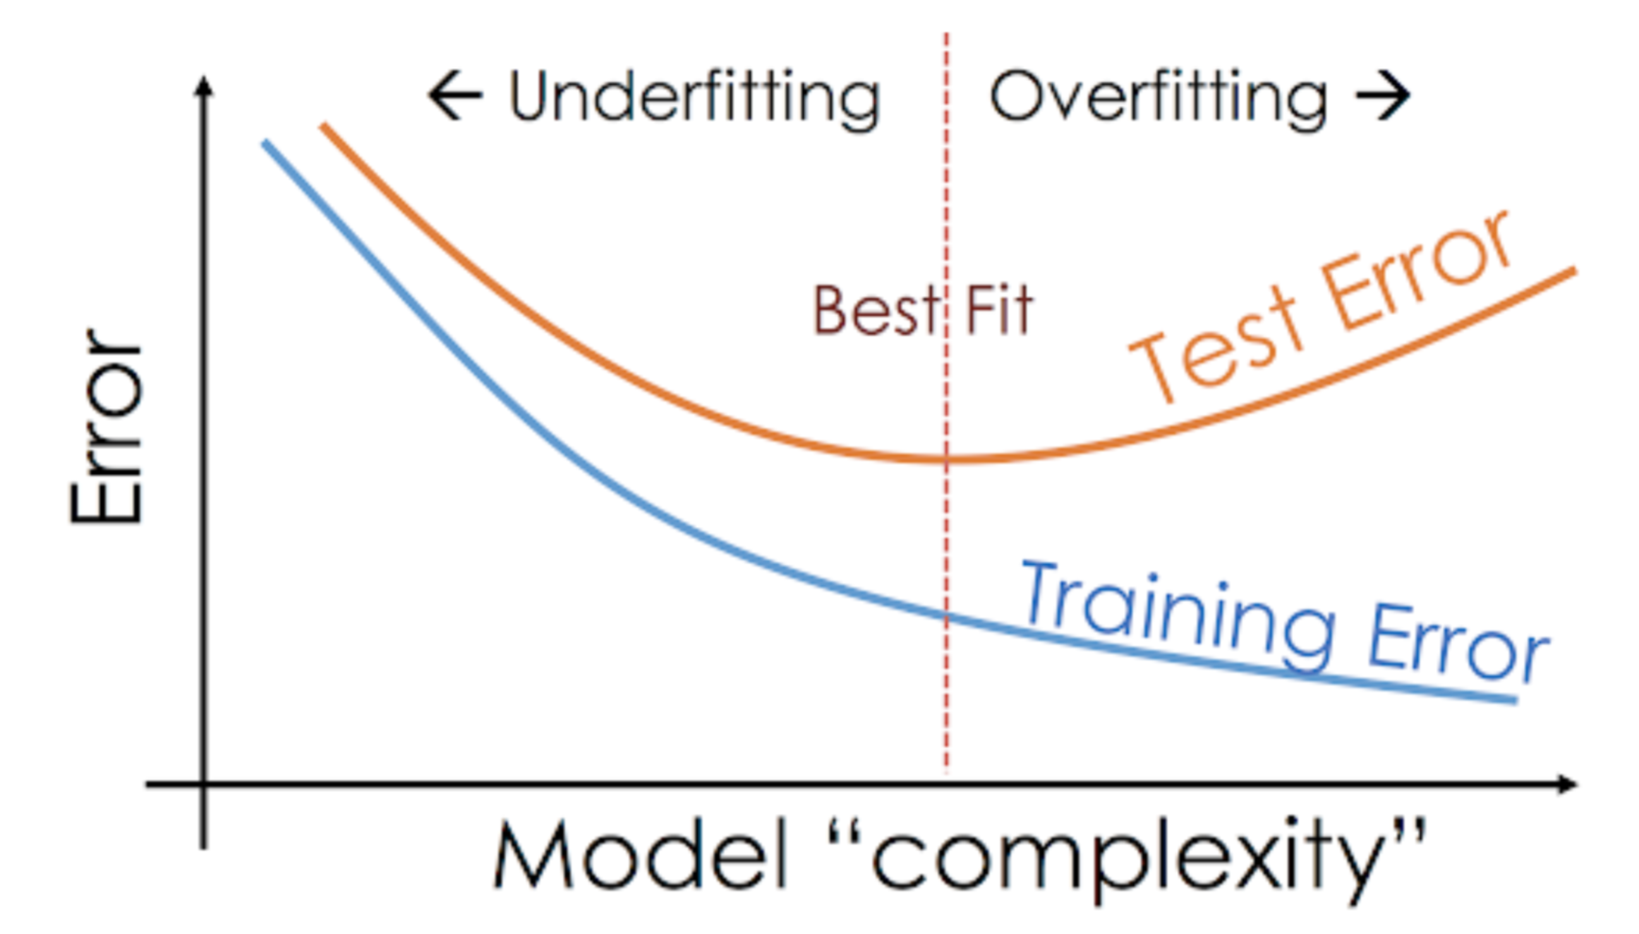

Slide 16
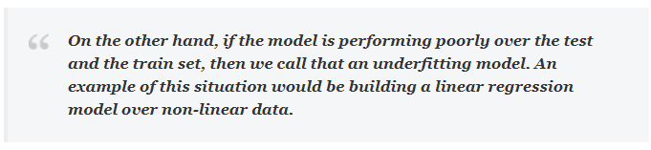

Slide 17
Overfitting
Can be generally termed as something when the ML model is extremely dependent on the training data.
The model is build from each data point view of the training data that it is not able to learn and fails drastically when exposed to new test data.
It mostly occurs in non-linear, non- parametric data.
Non-parametric refers to an assumption that the data doesn’t have a normal distribution.
It occurs mostly in complex algorithms like tree based models, KNN etc.

Slide 18
Overfitting
In simple words, Overfitting occurs when the model begins to memorize the training data instead of learning and understanding the underlying trend of the data. This results in the in efficiency of the model to perform well on new independent data.
As we all know, an overfitting model learns the training data really well and close from each data point view that it fails when new data is presented to it
A model with high variance and low bias is said to be overfitting.
For eg: if the accuracy of a ML model is 99% on training data but 50% on test data, then it is a clear case of overfitting.

Slide 19
Overfitting can be overcome by :
Cross validation techniques like K-fold cross validation.
Boosting and bagging.
Using linear models for linear data.
Grid search techniques or including parameters like maximum depth (Number of trees) for tree based algorithms can go a long way in solving overfitting issues.
Pruning in case of decision trees.
L1 regularization (Lasso regularization/penalization).
L2 regularization (Ridge regularization/penalization).

Slide 20
Underfitting:
An underfitting model is neither good to the training data nor the test data.
Inability of the model to understand/analyze the underlying trend/structure of the data, unable to derive critical information from the training data. This generally happens when there is not enough training data.
A model with high bias and low variance is said to be underfitting.
Underfitting might occur when we try to build linear models on non linear data.

Slide 21
Underfitting can be overcome by:
Using feature selection, creating more features from existing features etc.
Using Polynomial regression.
For eg: if the accuracy of a ML model is 55% on training data and 50% on test data, then it is a clear case of underfitting because the model is not performing well on both train and test data.
Underfitting mostly occurs in simple algorithms like Linear Regression

